Slide 1
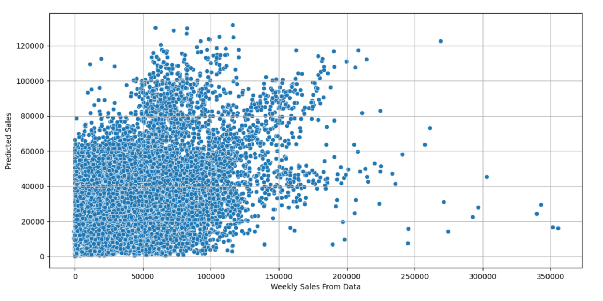
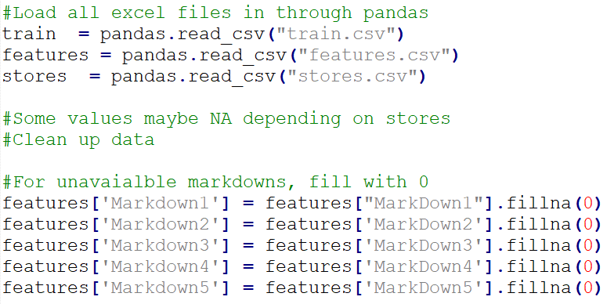
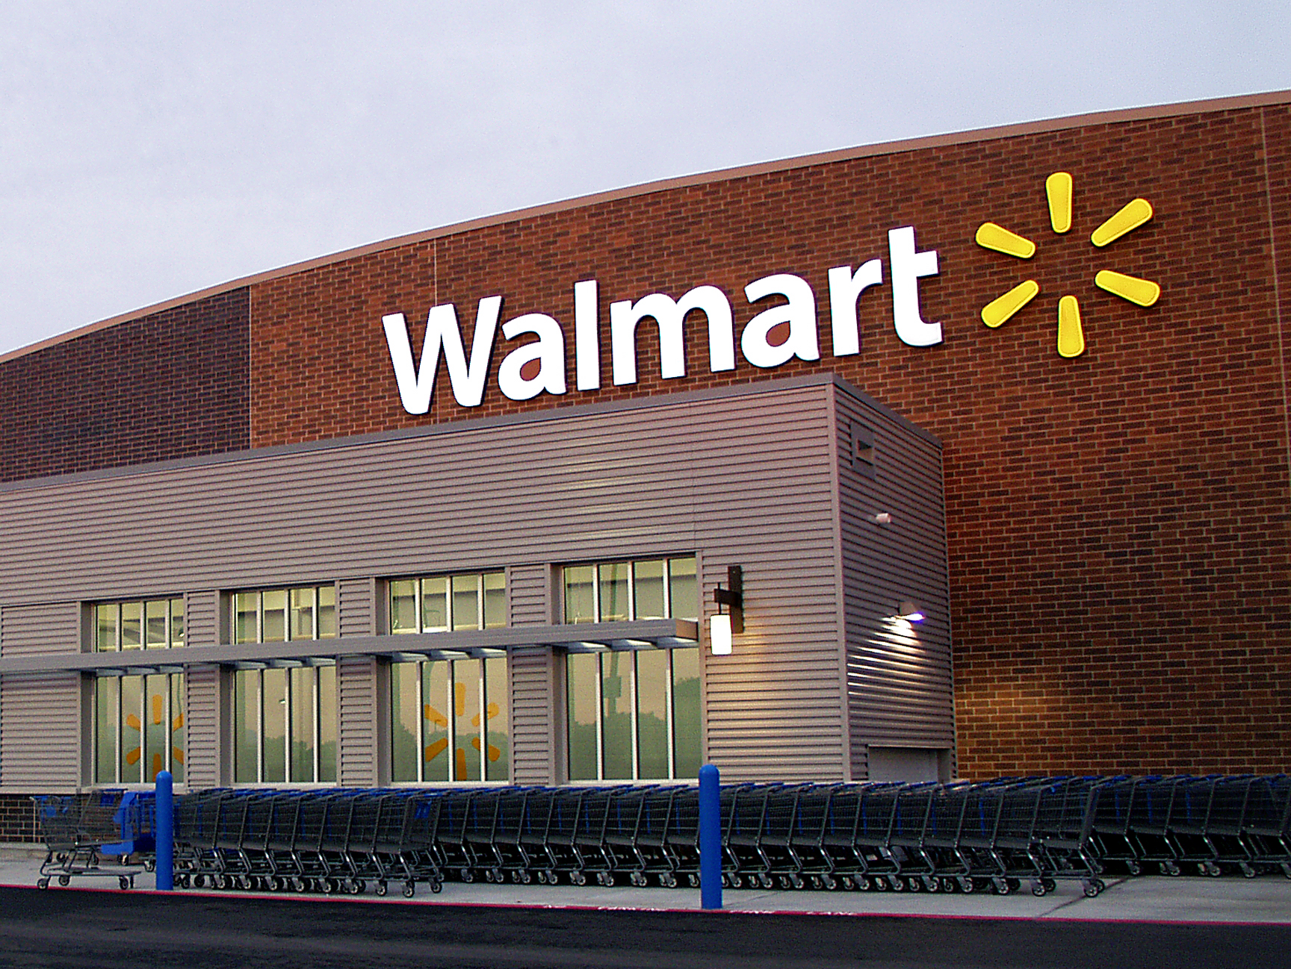
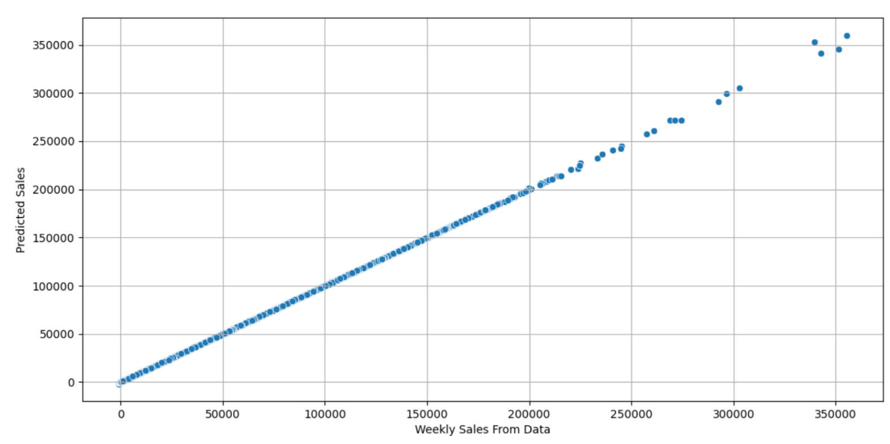
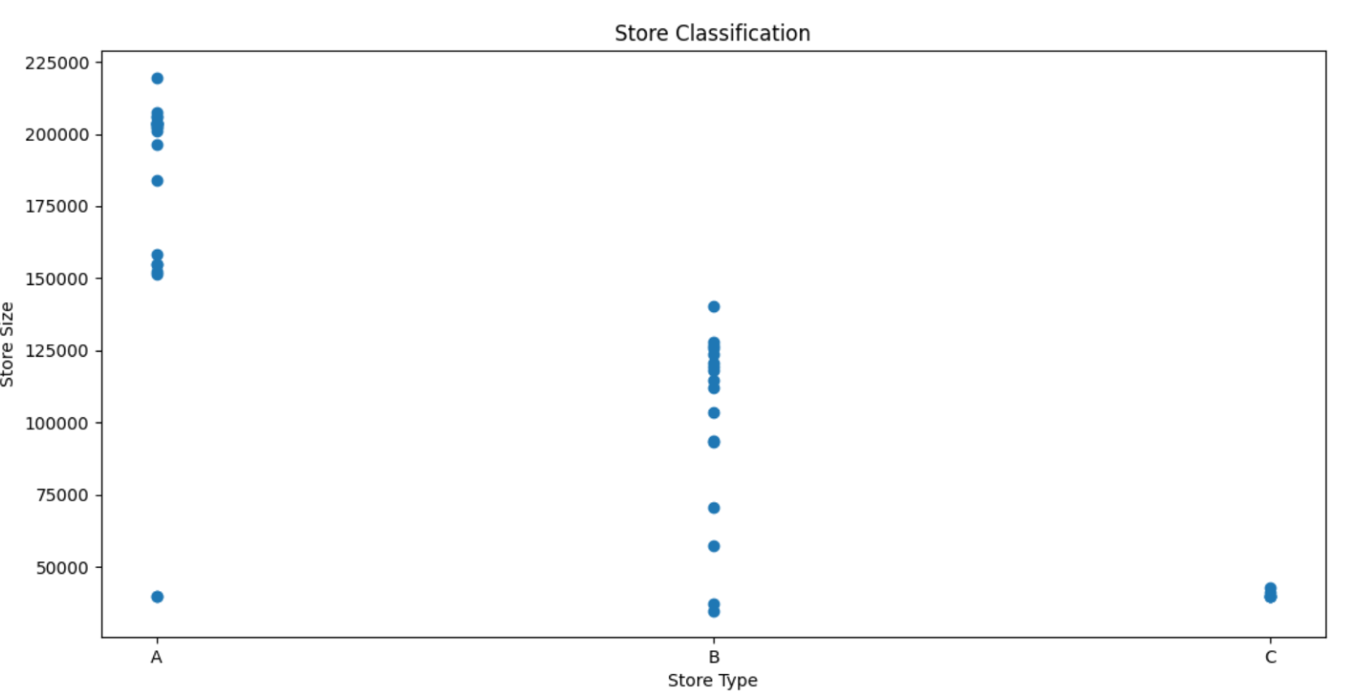
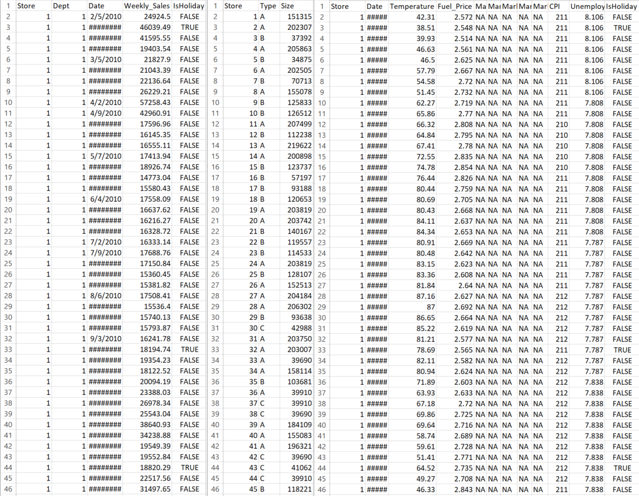
Forecasting Future Walmart Sales using KNN/Decision Tree Regression
Muhammad Salman – 100995527 - Masters of Engineering in Electrical and Computer Engineering
Seyedeh Marziyeh Zamiri – 101214196 - Masters of Engineering in Electrical and Computer Engineering
Professor Mikhail Genkin, DATA 5000 Y – March 30th, 2021
Introduction
Methodology
Results
Walmart Data set imported from Kaggle
Comprised of three main CSV files containing correlation of different features, based on data pulled from 45 different store locations, with a number of departments in each store
Features vary from numerical values, such as amount of sales, to boolean True/False for if a week contains a holiday or not
Goal is to build/train a model that can predict future Walmart sales based on a specific store/department and date
Data Cleaning
Once data was imported using Excel, all following data analysis was done using Python
The first step was to load the data using the Pandas package, and import the CSV table as a data frame
We proceeded to remove N/A data, as can be seen in the CSV screenshots in the Dataset section
Once completed, all three data frames were merged into one, named main
The main data frame was created by merging on common features between the three data frames, such as Store# and Date
KNN Regression
After adding/removing features, the data was split into 80% train, and 20% test, where the 20% would then be predicted by the model
The greatest success rate with was 37.8% with 15 Neighbors
MAE: 11035.06, MSE: 320087846.66, RMSE: 17890. 99
Figure 3: Code to Load CSV and Clean Data
Decision Tree Regression
The greatest success rate with was 99%
MAE: 1.48, MSE: 3457.50, RMSE: 59.56
Data Exploration
The next step was to explore the data and observe strong correlation between features
The three sets that were observed were: Type of Store vs. Weekly Sales, Type of Store vs. Size of Store, Is Holiday vs. Weekly Sales
Observations
Type of Store vs. Weekly Sales: Weak correlation, Type C seems to have least amount of sales, no strong difference between A and B
Type of Store vs. Size of Store: Strong Correlation, A is largest, B is second largest, C is smallest
Is Holiday vs. Weekly Sales: Some correlation, with slightly more sales when there was a holiday, however not as much as expected
Figure 1: Sample Walmart Store
Dataset
Relevant CSVs within the dataset are listed below, along with the features within each one
features.csv: Store #, Date, Local Temperature, Local Fuel Price, Markdown/Discounts, CPI index, Unemployment Index, and if the current week is a holiday
stores.csv: Store#, Type of Store, and size of store by number of products
train.csv: Store#, Department#, Date, Weekly Sales, and if the current week is a holiday
Conclusion
The more linear the graph, the stronger the model
Features such as day throw off model, week# makes it stronger
Decision Tree stronger than KNN
Figure 4: Type of Store vs. Size of Store
References
Data Modelling
In order to model the data, a machine learning model is normally selected
We initially selected the K Nearest Neighbors Regression model
Regression models allow a solid value to be predicted based on a series of dependent variables, such as we have in our case, since we are predicting future sales per store and department at certain dates
The KNN approach will allow features to be classified based on their similarities as described with input data
Predicted values will be classified based on how much their data resembles points in the dataset
This modelling can be done in python using scikit-learn library in Python
The strongest model had 15 nearest neighbors selected, with features such as date broken into Y-M-D, where day/year were ignored for better prediction
However, a stronger model was discovered using Decision Tree regression
A Decision Tree parses the data through smaller nodes, known as decision nodes, until it achieves the target or leaf node, which is Weekly Sales in this case
[1] Kaggle.com. 2014. Walmart Recruiting - Store Sales Forecasting | Kaggle. [online] Available at: https://www.kaggle.com/c/walmart-recruiting-store-sales-forecasting/data [Accessed 31 January 2021].
Acknowledgments
We would like to thank the organizers of Data Day for allowing us to present our Walmart Forecaster Project, as a part of the DATA 5000 course.
We would also like to thank Professor Michael Genkin for his dedication and support during the semester, as well as Professor Komeili and Professor Velazquez for teaching the course.
Figure 2: Snapshot of Three CSV files, Train, Stores, Features (Left to Right)

